Slide 1

Project Title: Behavioral Finance Patterns in Predicting Global Financial Crises: An Analytical Approach to Crisis Forecasting
Domain: Economics & Finance
Second Review
Course Code: CS6510
Course Title: Project 1
Register Number: 23MSP3068
Name: Dharshani A.
Date: 05-12-2023

Slide 2
Abstract
The financial sector's constant evolution necessitates predictive models for crisis prevention. This study, using a dataset from Global Financial Crisis Analytics, constructs a predictive model by integrating SARIMAX time series analysis with advanced machine learning.
With goals to predict global financial crises and understand economic fluctuations, the methodology, rooted in behavioral finance, employs regression analysis and pattern recognition. The findings reveal a clear relationship between specific economic indicators and the onset of financial crises.
The research's outcomes carry significant implications for policymaking and investments, offering new directions to mitigate financial risks. By merging econometric techniques with modern machine learning, this study provides fresh insights into behavioral finance and a robust model for predicting economic downturns.
Keywords: Global Financial Crisis, Predictive Modeling, Economic Indicators, Machine Learning, Time Series Analysis, SARIMAX, Logistic Regression Analysis, Behavioral Finance.

Slide 3
Introduction
This research conducts a thorough examination of key elements crucial for understanding financial dynamics, with a specific focus on historical economic data and market behaviors, especially during past global financial downturns.
Utilizing datasets from Global Financial Crisis Analytics, the study uniquely integrates SARIMAX time series analysis, advanced machine learning with logistic regression, and LSTM neural networks to develop an innovative approach for identifying patterns indicative of financial crises.
Rooted in behavioral finance principles, the methodology places a strong emphasis on the interplay between market behaviors and economic indicators in the lead-up to financial crises.
With the goal of forecasting and decoding financial instability with analytical precision, the research anticipates outcomes such as global crisis prediction, insights into economic fluctuations, and meaningful implications for policy-making and investment decisions.
Ultimately, this study aspires to provide accessible insights into behavioral finance, enriching our understanding of economic downturns and crisis forecasting within the field.

Slide 4
Need for Research
To ensure ongoing vigilance in the financial sector, policymakers, and among investors for anticipating and mitigating future financial downturns.
Identifying early warning signals and patterns that historically precede financial crises, offering a proactive approach to maintaining economic stability.
Analyzing the changes in economic indicators leading up to the 2007-2008 crisis with the aim of forecasting future financial downturns.
Enabling stakeholders to take preemptive measures to protect the global economy by predicting potential crises.

Slide 5
Problem Statement
Traditional economic forecasting methods often fall short in accurately predicting financial crises due to their limitations in capturing complex and seasonal trends.
This study proposes a novel model that integrates SARIMA, known for its proficiency in seasonal analysis, with Neural Networks, renowned for uncovering non-linear patterns.
By incorporating LSTM into predictive analytics to capture sequential dependencies and time-series predictions, this hybrid approach aims to equip policymakers with timely and actionable insights.
The goal is to significantly enhance the precision of crisis prediction, thereby fortifying the development of robust economic defense strategies.

Slide 6
Objectives
To undertake data preprocessing and conduct exploratory analysis on the chosen dataset.
To design a model that utilizes the SARIMAX technique, known for its ability to analyze seasonal fluctuations, for the four types of crises (Banking, Systemic, Currency, and Inflation).
To apply LSTM networks to explore and model intricate temporal relationships within economic time-series data.
To innovate a hybrid methodology that combines the strengths of machine learning with econometric models to improve prediction accuracy.
To execute a comparative study to evaluate the performance of the proposed hybrid models against established forecasting techniques.

Slide 7
Related Work
We aim to develop a predictive model for forecasting global financial crises by integrating SARIMAX time series analysis with advanced machine learning techniques. This work builds upon several key studies in this area.
Historical Economic Data and Market Behaviors:
Prior research has emphasized the importance of analyzing historical economic indicators and market behaviors in the lead-up to financial crises. Minsky (1992) first proposed the financial instability hypothesis, arguing that prolonged periods of economic prosperity typically sow the seeds of future crises. Reinhart and Rogoff (2009) conducted an extensive study of eight centuries of financial crises, finding common patterns in asset prices, capital flows, and credit growth preceding downturns.
Behavioral Finance Perspectives:
A behavioral finance lens can provide useful insights. Shiller (2005) highlighted the role of changing investor psychologies and social epidemics in driving boom-bust cycles. Akerlof and Shiller (2009) proposed animal spirits as an explanation for economic fluctuations. Kahneman and Tversky (1979) established prospect theory, showing how loss aversion and reference-dependent preferences can influence market behaviors.

Slide 8
Related Work
Econometric Techniques:
Time series analysis is commonly applied. Sims (1980) pioneered vector autoregression (VAR) modeling to study macroeconomic dynamics. Box and Jenkins (1976) developed autoregressive integrated moving average (ARIMA) models for forecasting and understanding stochastic processes. Engle (1982) introduced autoregressive conditional heteroskedasticity (ARCH) models to capture volatility clustering.
Machine Learning Applications:
Recent studies have begun combining econometrics with machine learning. Borio et al. (2012) applied signal extraction techniques to detect early warning signs. Aikman et al. (2019) developed deep learning models for forecasting recessions using large datasets. Arner et al. (2020) proposed a hybrid machine learning-macroeconomic approach for systemic risk monitoring.
We aim to advance this literature by uniquely integrating SARIMAX with advanced machine learning methods through a behavioral finance lens. The proposed methodology leverages the strengths of econometrics, machine learning, and behavioral insights to develop a novel predictive model for global financial crises forecasting. This has the potential to significantly impact policymaking and investment decisions.
CS6501 Project I PGP, ICER, VIT Bangalore
8

Slide 9
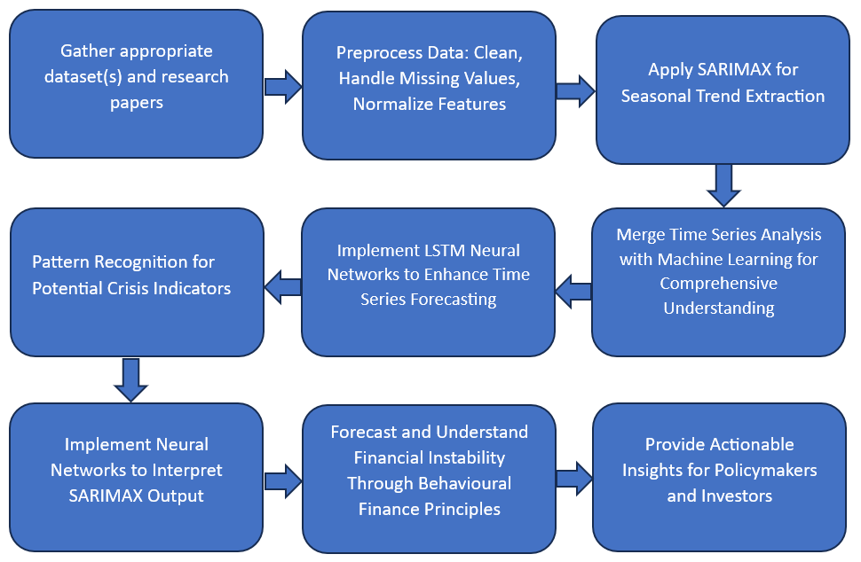
Proposed Methodology

Slide 10
Proposed Methodology
The approach involves:
  Collecting financial datasets and literature
  Preprocessing data
  Applying SARIMAX to detect seasonal trends
  Identifying patterns in crisis indicators using LSTM neural networks
The analysis merges time series with machine learning for depth and employs neural networks to interpret SARIMAX outcomes.
Behavioral finance principles aid in forecasting financial instability, providing actionable insights for policymakers and investors.
Comparisons will be made against historical averages, traditional ARIMA models, and expert financial analysis to validate the approach's efficacy.

Slide 11
Proposed Methodology
When it comes to baselines to compare against…
  Historical Averages: Comparing the model's performance against the simple historical average to ensure that the model provides a significantly better forecast.
  Traditional Time Series Models: Such as ARIMA, to show the added value of using more complex models like SARIMAX and LSTM.
  Expert Analysis: Comparing the model's insights against those from financial analysts to validate the model's practical relevance.

Slide 12
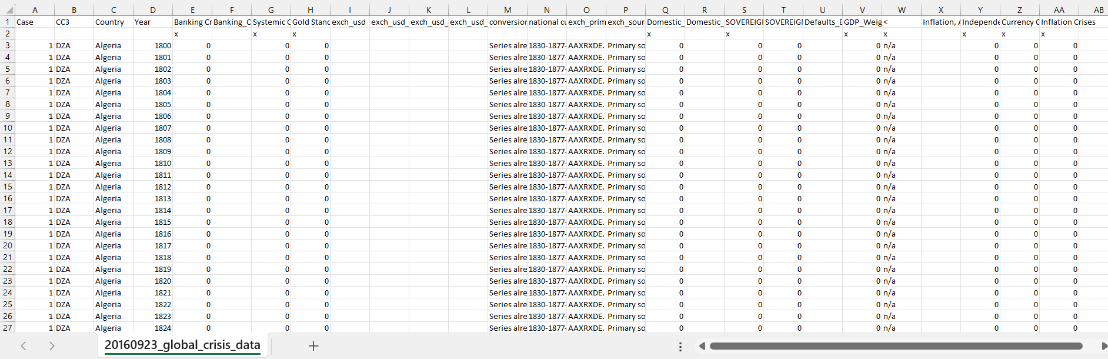
Dataset
Source of the Dataset: Global Financial Crisis Analytics | Kaggle
No. of Observations: 15,192
Screenshot of the dataset
CS6501 Project I PGP, ICER, VIT Bangalore
12

Slide 13
Column/Feature Details of the Dataset
1. Case: A numeric identifier for each record. Each country appears to have a unique case number.
2. CC3: The three-letter country code, following the standard ISO alpha-3 country codes.
3. Country: The name of the country to which the data row corresponds.
4. Year: The year for which the data is recorded.
5. Banking Crisis: Indicates the occurrence of a banking crisis. '0' indicates no crisis, while '1’ indicates a crisis.
6. Banking_Crisis_Notes: Additional notes or explanations about the banking crisis, if any.
7. Systemic Crisis: Indicates whether a systemic crisis occurred in that year. Similar to 'Banking Crisis', '0' likely means no systemic crisis.
8. Gold Standard: Indicates whether the country was on the gold standard in that year.
9. exch_usd: The exchange rate of the country's currency to the US dollar.
10. exch_usd_alt1, exch_usd_alt2, exch_usd_alt3: Alternative exchange rate values, representing different sources or calculation methods.
11. Conversion to USD notes/sources: Notes or sources for the exchange rate data.

Slide 14
Column/Feature Details of the Dataset (continued)
12. Domestic Debt In Default: Indicates whether there was a default on domestic debt.
13. Domestic_Debt_ Notes/Sources: Notes or sources regarding the domestic debt data.
14. SOVEREIGN EXTERNAL DEBT 1 and 2: Indicates whether there was a default or restructuring of sovereign external debt. Different columns might represent different categorizations or time periods of the debt.
15. Defaults_External_Notes: Notes about external debt defaults.
16. GDP_Weighted_default: A measure of defaults weighted by GDP, possibly indicating the severity or impact of the default relative to the country's economy.
17. Inflation, Annual percentages of average consumer prices: The annual inflation rate, measured as the percentage change in consumer prices.
18. Independence: Indicates whether the country was independent in that year.
19. Currency Crises: Indicates the occurrence of a currency crisis.
20. Inflation Crises: Indicates the occurrence of an inflation crisis.

Slide 15
Details about the columns
Categorical Columns:
CC3, Country, Banking Crisis, Banking_Crisis_Notes, Systemic Crisis, Gold Standard, exch_usd, exch_usd_alt2, exch_usd_alt3, conversion_notes, national currency, exch_primary source code, exch_sources, Domestic_Debt_In_Default, Domestic_Debt_Notes/Sources, SOVEREIGN EXTERNAL DEBT 1: DEFAULT and RESTRUCTURINGS, 1800-2012, SOVEREIGN EXTERNAL DEBT 2: DEFAULT and RESTRUCTURINGS, 1800-2012, Defaults_External_Notes, GDP_Weighted_default, "<", Inflation, Annual percentages of average consumer prices, Independence, Currency Crises, Inflation Crises.
Continuous Columns:
Case, Year, exch_usd_alt1.
Discrete Columns:
None identified as discrete based on the provided data.

Slide 16
Performance Analysis
S.No | Authors | Year | Methodology Used | Performance Metrics | My Methodology
1 | Harvard Business School | 2018 | Regression, Econometrics, Machine Learning | Analysis of financial risks and instabilities | SARIMAX, LSTM, and other advanced ML models
2 | Tekin H. | 2020 | Cash Management Strategies Analysis | Changes in Cash Management Strategies | Enhanced predictive accuracy using SARIMAX and LSTM
3 | World Bank | 2020 | Analytical Review of Bank Regulation and Supervision | Policy and regulatory insights | Combining SARIMAX with LSTM for deeper economic insights
4 | Lajili K. et al. | 2023 | Corporate Risk Disclosure Analysis | Analytical and Evaluative Research | Leveraging SARIMAX and LSTM for risk prediction
5 | Shehzad K. et al. | 2020 | Comparative Analysis of COVID-19 and Financial Crisis | Comparative Analysis | Applying SARIMAX and LSTM to model crisis scenarios
6 | Lolea I.-C. et al. | 2021 | ARIMA, Machine Learning (Prophet, KNN, Neural Networks) | Neural Networks excel in Predictive Accuracy | Integrating SARIMAX and LSTM for enhanced forecasting
7 | Tang Y. M. et al. | 2020 | AI-Driven Time Series Forecasting in Logistics Sector | Advanced Analytical Approach | SARIMAX and LSTM for robust time series analysis
8 | Liu J. et al. | 2023 | ARIMA, GARCH, Random Forest during Russia-Ukraine War | Comprehensive Economic Analysis | SARIMAX and LSTM for complex economic event analysis
9 | Zulkefly R. N. et al. | 2020 | Financial Inclusiveness and Economic Growth Analysis | Impact of Financial Inclusiveness | Applying SARIMAX and LSTM for economic growth analysis
10 | Hossain M. J. | 2023 | SARIMAX, ARIMA, Random Forest for GDP and Unemployment Rate | Predictive Capabilities and Differences Noted | Advanced ML techniques for refined economic predictions

Slide 17
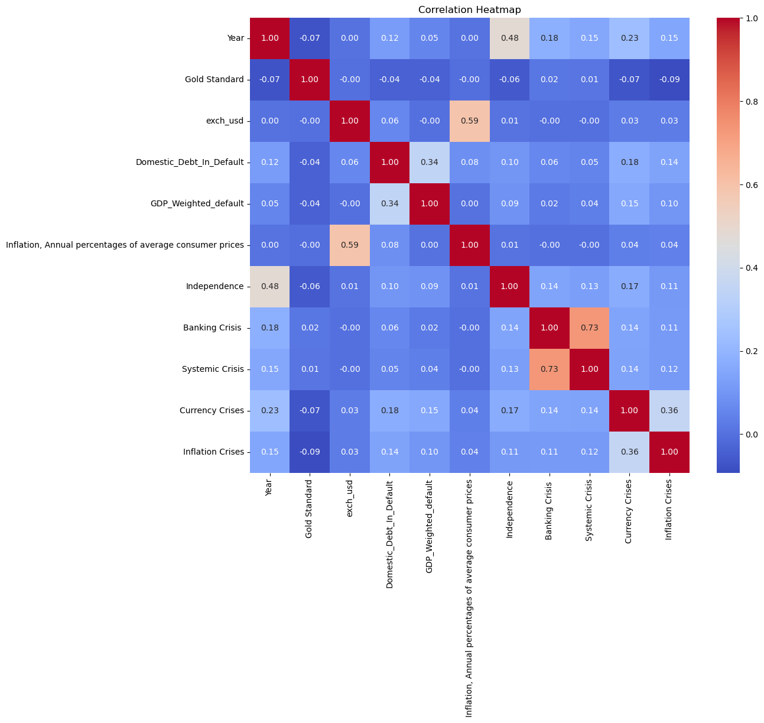
Results and Discussion
Banking Crisis and Systemic Crisis (0.73): A strong positive correlation, indicating that these types of crises often occur together.
Domestic_Debt_In_Default and GDP_Weighted_default (0.34): A moderate positive correlation, suggesting a relationship between GDP-weighted defaults and domestic debt defaults.
Currency Crises and Inflation Crises (0.36): A moderate positive correlation, implying that currency crises might be linked with inflation crises.
Inflation (annual percentages of average consumer prices) and Exchange Rate (exch_usd) (0.59): A strong positive correlation, indicating that higher inflation rates are often associated with a weaker currency against the US dollar.

Slide 18
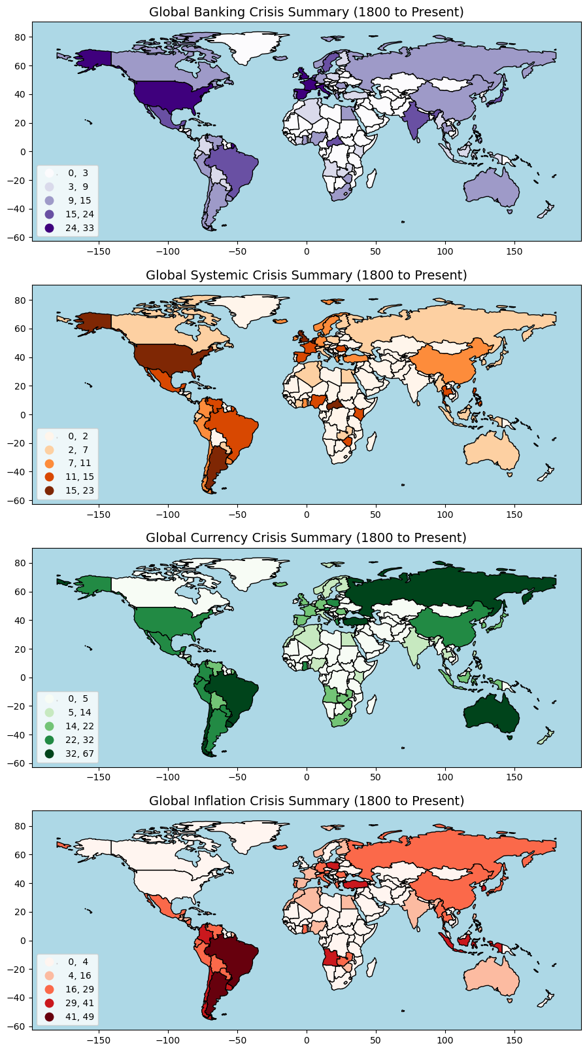
Results and Discussion

Slide 19
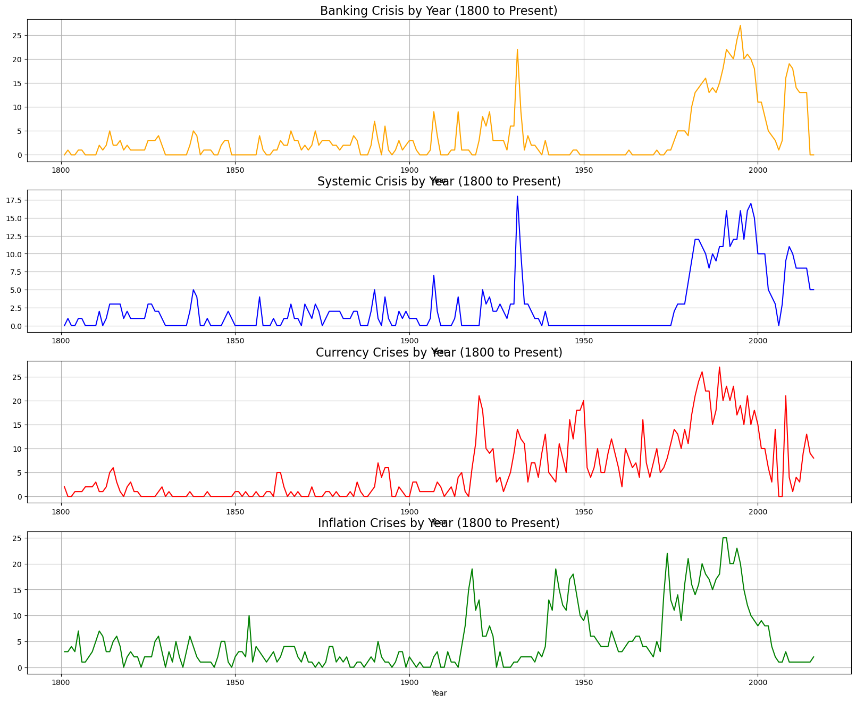
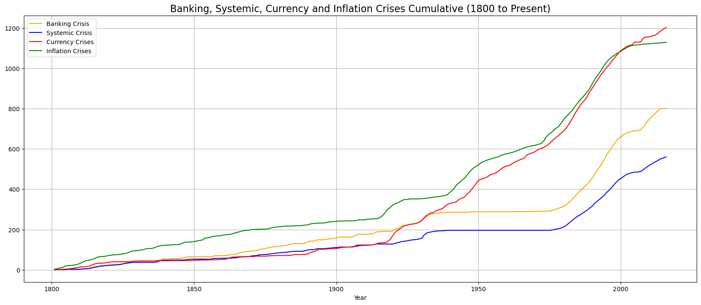
Results and Discussion
The graph indicates that all types of crises have become more common over time, with inflation crises showing the most pronounced increase. This could reflect various economic trends, policy changes, and evolving financial systems globally. The cumulative nature of the graph underscores the continuing impact and rising frequency of these economic events over time.

Slide 20
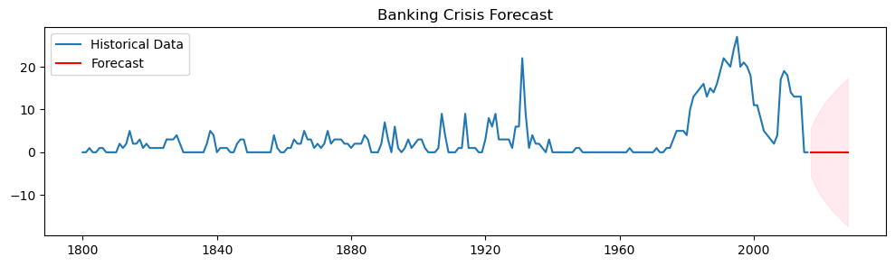
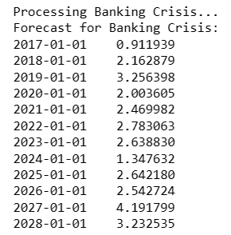
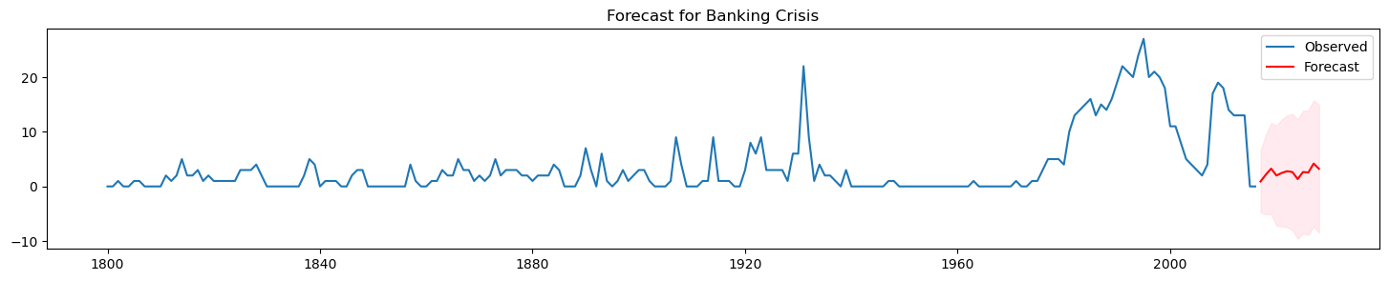
Results and Discussion
ARIMA vs. SARIMAX – Banking Crisis
The graph displays a time series forecast for banking crises, with historical occurrences shown in blue and future predictions in red. The forecast predicts a fluctuating trend of crises severity from 2017 to 2028, with increasing uncertainty over time.

Slide 21
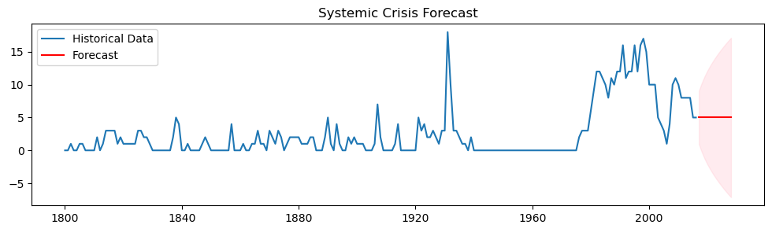
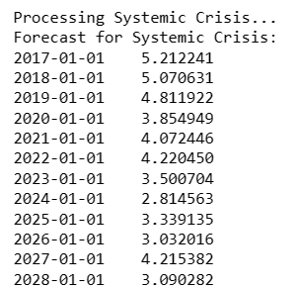
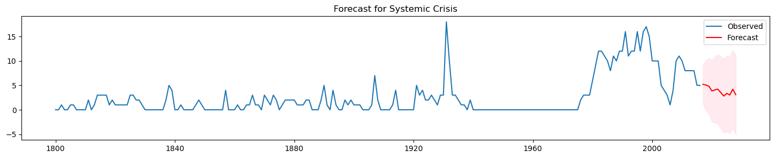
Results and Discussion
ARIMA vs. SARIMAX – Systemic Crisis
The graph shows past systemic crises and projects future trends from 2017 to 2028. The forecast indicates a decrease in crisis severity, with growing predictive uncertainty as time advances.

Slide 22
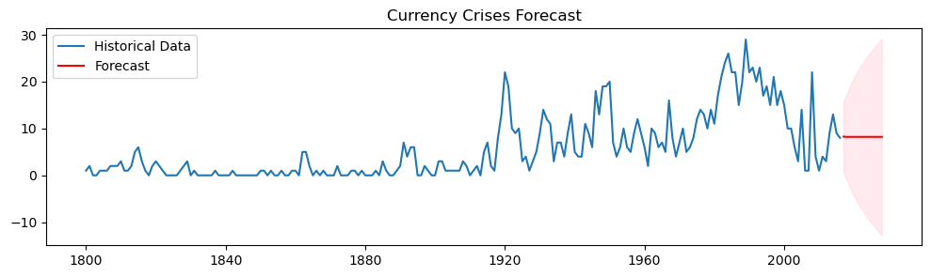
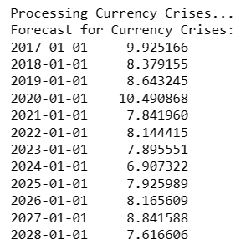
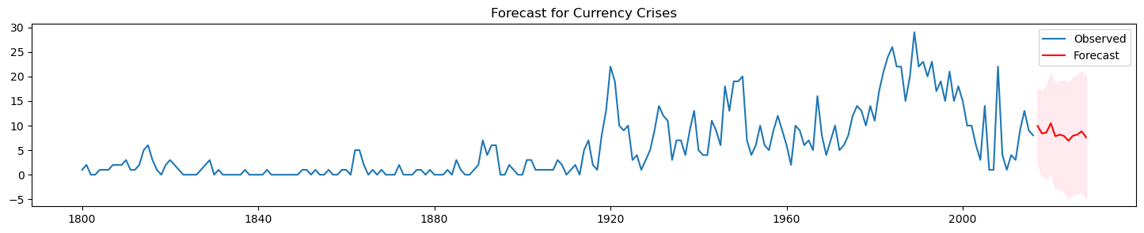
Results and Discussion
ARIMA vs. SARIMAX – Currency Crisis
The image shows a forecast for currency crises, with historical data in blue and predictions in red extending from 2017 to 2028. The model suggests a potential decline in crisis severity, amid increasing forecast uncertainty over time.

Slide 23
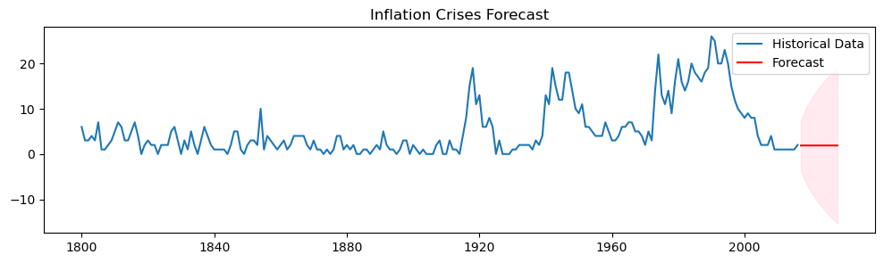
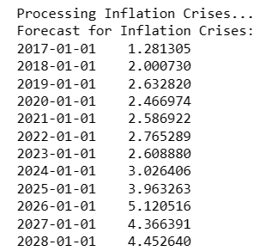
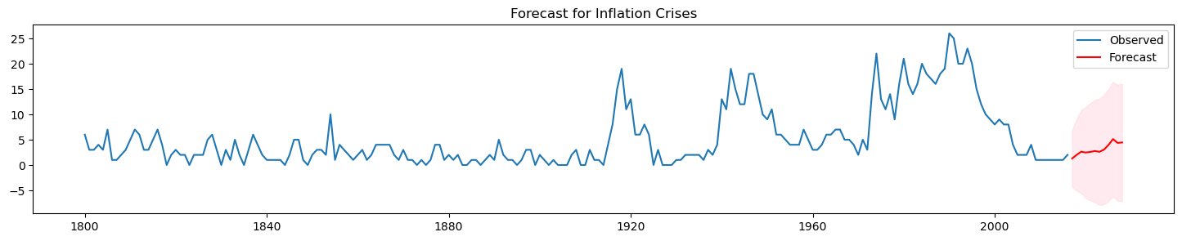
Results and Discussion
ARIMA vs. SARIMAX – Inflation Crisis
The graph displays a forecast for inflation crises, showing historical occurrences in blue and future predictions in red through 2028. The trend predicts an increase in the frequency or severity of inflation crises, with a widening range of uncertainty.

Slide 24
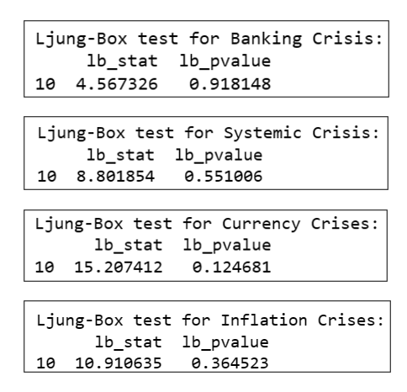
Results and Discussion
The p-value of 0.918148 is very high, suggesting that there is no significant autocorrelation at any of the first 10 lags of the residual time series for banking crises.
The p-value of 0.551086 is also high, indicating no significant autocorrelation at the first 10 lags for systemic crises.
With a p-value of 0.124681, this result is lower but still above the common significance threshold of 0.05, suggesting no significant autocorrelation at the first 10 lags for currency crises.
The p-value of 0.364523 indicates no significant autocorrelation at the first 10 lags for inflation crises.
In all cases, the Ljung-Box test does not provide evidence against the null hypothesis of no autocorrelation, which suggests that the residuals of the time series models for these crises are random, indicating a good model fit without autocorrelation issues.

Slide 25




Results and Discussion
Performance Evaluation of LSTM Model Across Different Economic Crises
The LSTM model's RMSE of 2.42 for training shows a close fit to training data, while 6.31 for testing indicates less accuracy in predicting new data, reflecting its generalization capability.
The LSTM model's RMSE of 0.14 for training and 0.15 for testing suggests high accuracy and effective generalization, with predictions closely aligning with actual values in both datasets.
The LSTM model shows strong fit and accuracy with RMSEs of 0.25 for training and 0.28 for testing, indicating reliable predictions for both training and unseen data.
The LSTM model's RMSE of 0.23 for training and 0.21 for testing indicates high accuracy and effective generalization, with closer predictions to actual values in both training and unseen data.

Slide 26
Conclusion
Validated LSTM and SARIMAX models' predictive precision for economic crises.
Demonstrated superior performance of SARIMAX over traditional ARIMA methods.
Revealed potential applications in policy-making and investment strategy enhancement.
Contributed new insights to behavioral finance and crisis prediction literature.

Slide 27
Future Enhancements
Expand datasets to include more diverse economic indicators.
Explore real-time data integration for dynamic forecasting.
Test additional ML algorithms for improved accuracy.
Conduct cross-country analyses for universal applicability.
Develop a more sophisticated model blending for robust predictions.

Slide 28
References : APA format
Harvard Business School. (2018). 2018 Financial Risk and Regulation Survey: Behavioral Finance & Financial Stability.
Tekin, H. (2020). How optimal cash changed by the global financial crisis?. Economics and Business Letters, 9(2), 114-123.
World Bank. (2020). Global Financial Development Report 2019/2020: Bank Regulation and Supervision a Decade after the Global Financial Crisis.
Lajili, K., Li, T. M., Chourou, L., Dobler, M., & Zéghal, D. (2023). Corporate risk disclosures in turbulent times: An international analysis in the global financial crisis. Journal of International Financial Management & Accounting.
Shehzad, K., Xiaoxing, L., & Kazouz, H. (2020). COVID-19’s disasters are perilous than Global Financial Crisis: A rumor or fact?. Finance Research Letters, 36.
Lolea, I.-C., Petrariu, I.-R., & Giurgiu, A. (2021). ARIMA vs. MACHINE LEARNING IN TERMS OF EQUITY MARKET FORECASTING. The Annals of the University of Oradea. Economic Sciences, XXX(2), 299-308.
Tang, Y. M., Chau, K.-Y., Li, W., & Wan, T. W. (2020). Forecasting Economic Recession through Share Price in the Logistics Industry with Artificial Intelligence (AI). Computation, 8(3).
Liu, J., Yan, R., & Zhang, Y. (2023). Stock Market Forecasting Using the ARIMA GARCH and Random Forest Model During The Russia–Ukraine War. Applied Economics and Policy Studies book series (AEPS), Springer.
Zulkefly, R. N., Karim, A. A., Rahman, A. A., & Sarmidi, T. (2020). Financial inclusiveness and economic growth: New evidence using a threshold regression analysis. Economic Research-Ekonomska Istraživanja, 33(1), 1465-1484.
Hossain, M. J. (2023). Comparative Analysis of ARIMA SARIMAX and Random Forest Models for Forecasting Future GDP in Relation to Unemployment Rate.

